Slide 3

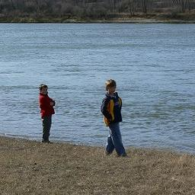
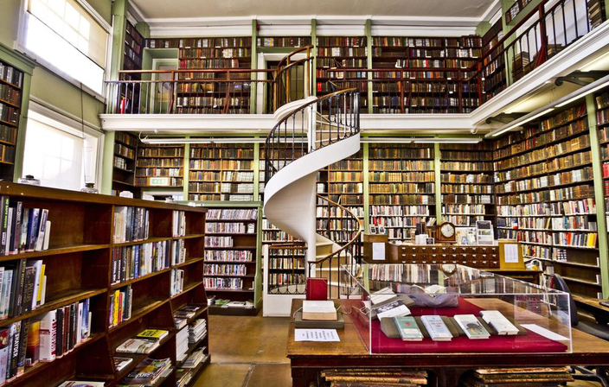
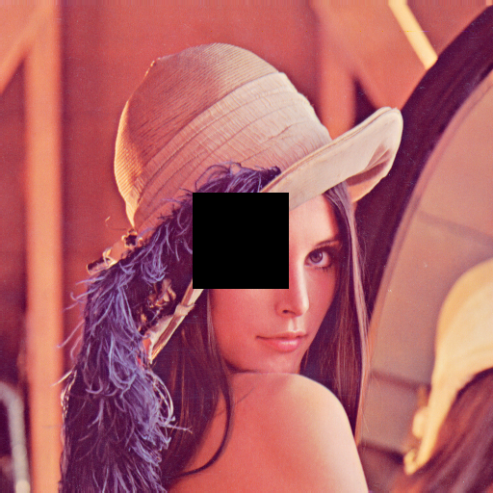
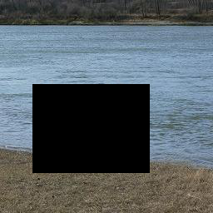
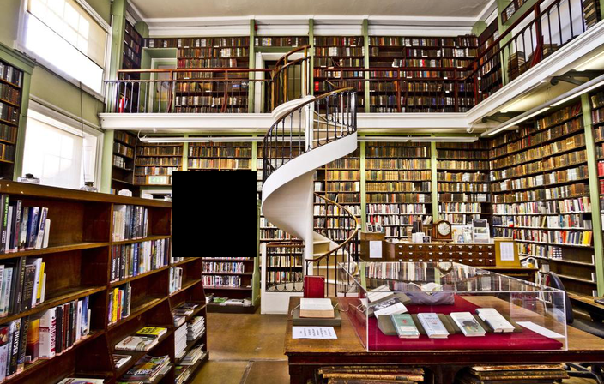
original Image
corrputed Image

Slide 4
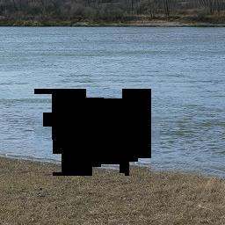
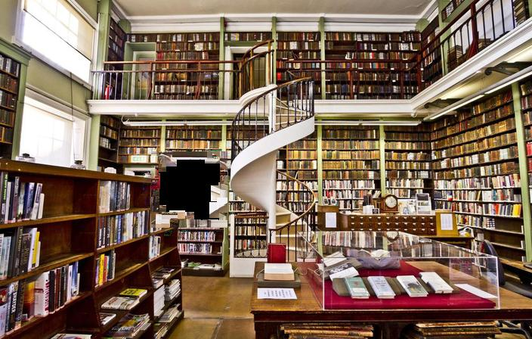
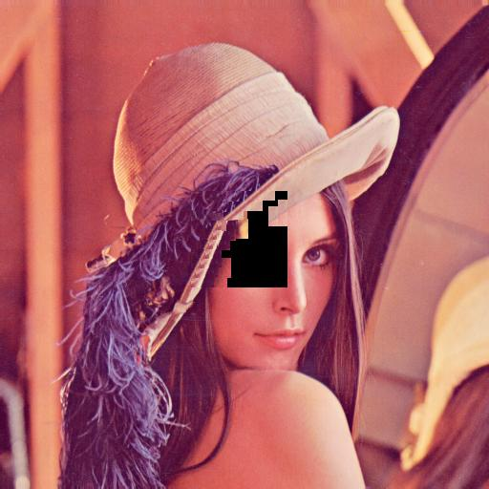
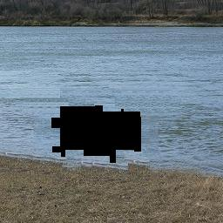
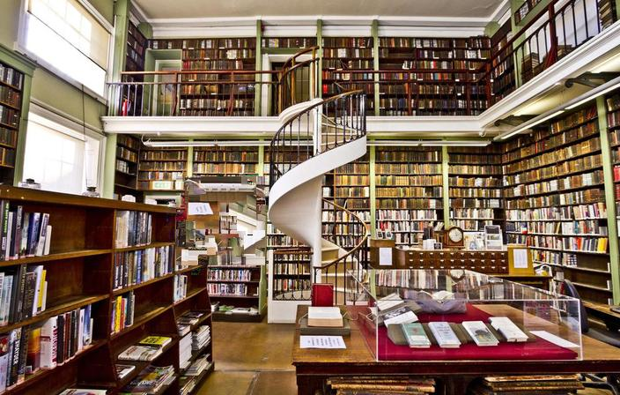
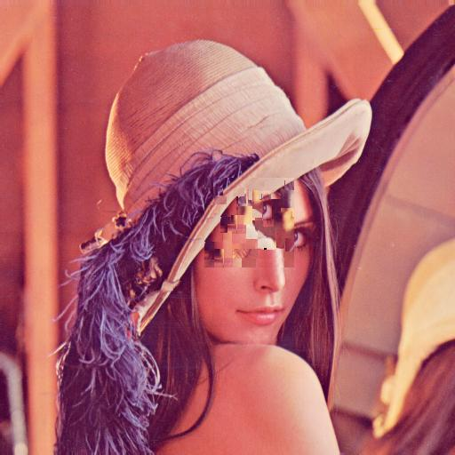
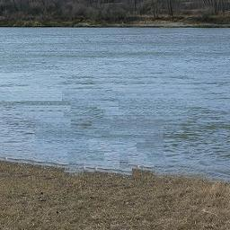

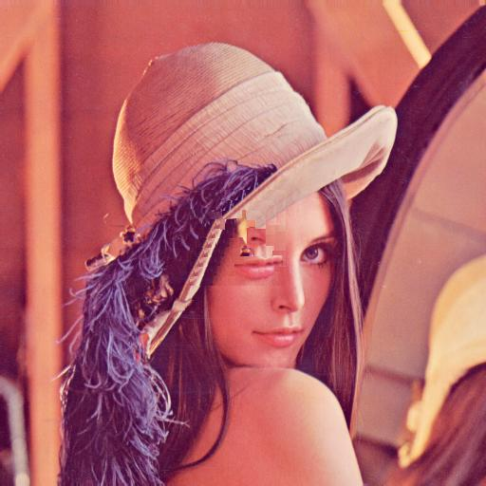
40 80
Stage 1
Stage 2
Stage 3

Slide 5

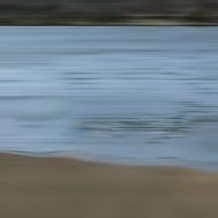
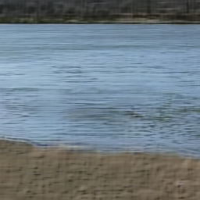
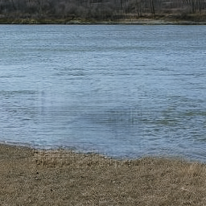
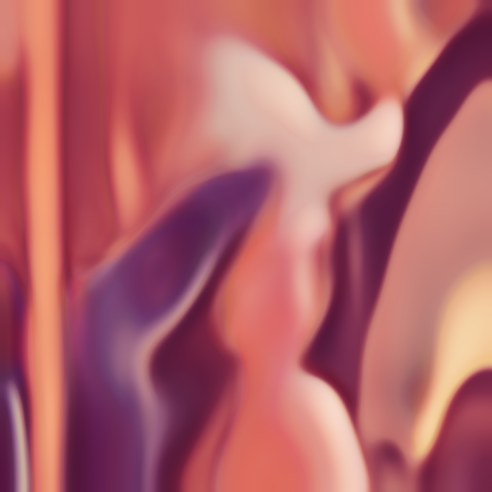
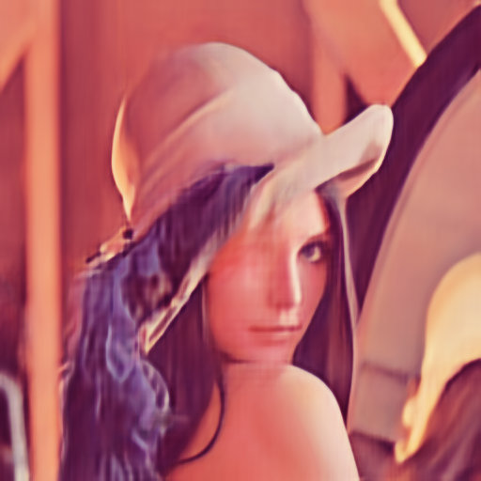

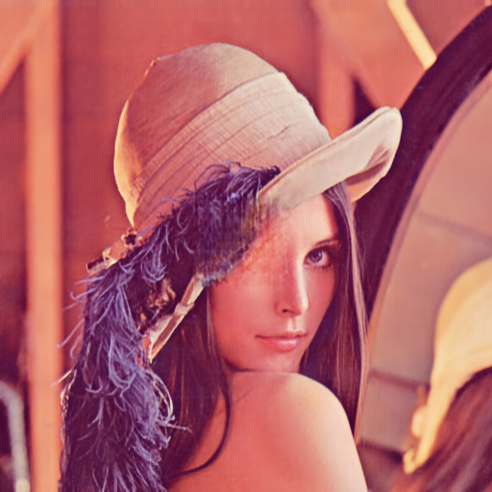
no reg epoch 100,1000,2000,5000
iter = 100 iter = 1000 iter =2000 iter =5000

Slide 6
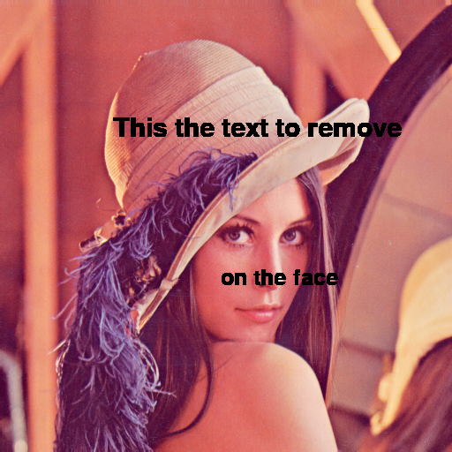
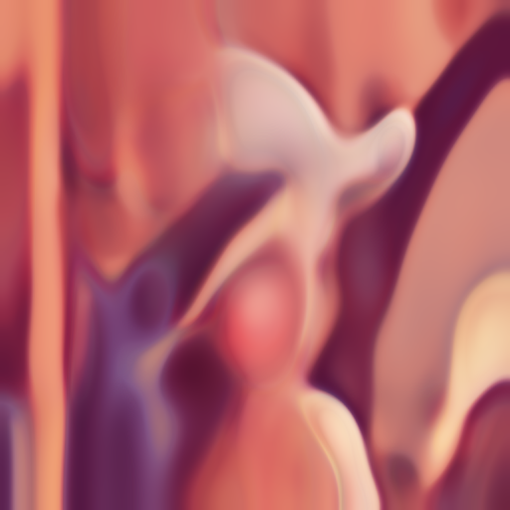



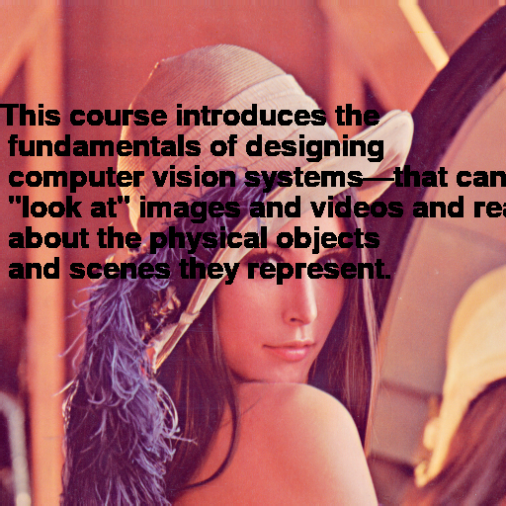
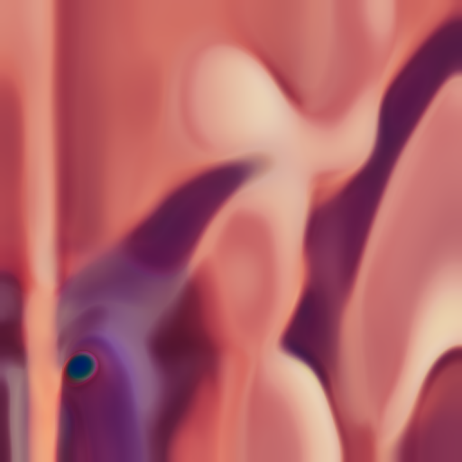



no reg /text roemv epoch 100,1000,2000,5000
Corrupted image
iter = 100
iter = 1000
iter = 2000
iter = 5000
psnr = 18.90
psnr = 20.84
psnr =21.18
psnr = 21.47
psnr = 13.90
psnr = 14.50
psnr = 16.62
psnr = 14.66

Slide 7
no reg /text roemv epoch 100,1000,2000,5000
Corrupted image
iter = 100
iter = 1000
iter = 2000
iter = 5000
psnr = 18.90
psnr = 20.84
psnr =21.18
psnr = 21.47
psnr = 13.90
psnr = 14.50
psnr = 16.62
psnr = 14.66

Slide 8
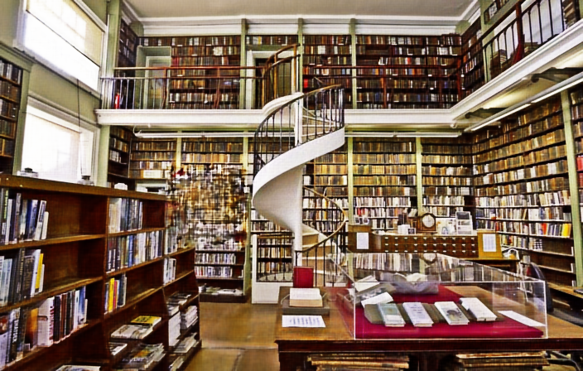
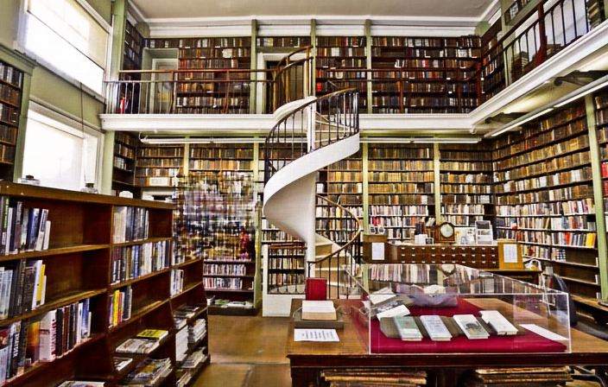
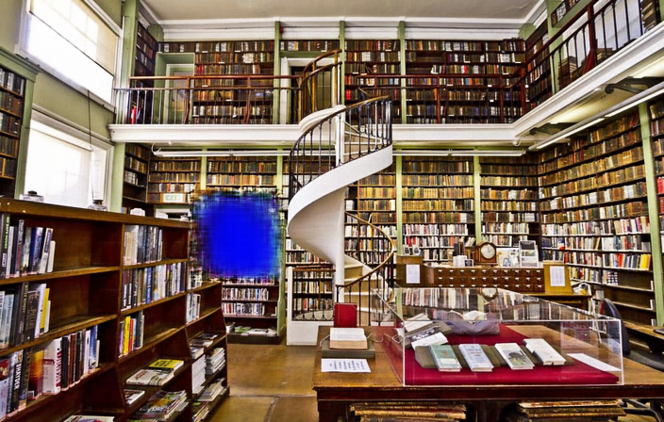
lr = 0.1/0.01/0.001
1000 best
noReg
Reg
lr = 0.1 lr = 0.01 lr = 0.001
psnr = 20.25 psnr = 20.73 psnr = 21.44

Slide 9
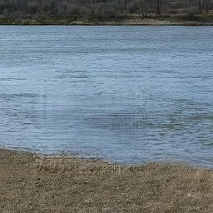

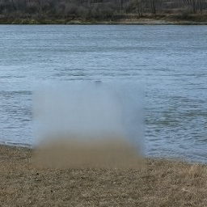
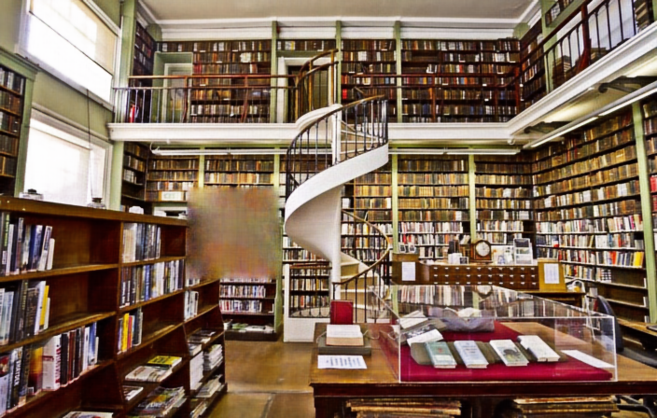
lr = 0.01
best
no reg/reg w = 0.1
psnr = 20.03 psnr = 11.34 psnr = 20.74
psnr = 19.93 psnr = 11.17 psnr = 20.80

